Slide 1
Smart Brain Box
Sarah Giron Tao, Gabriela Saenz,
Geetika Vedula, Aishani De Srikar

Slide 2
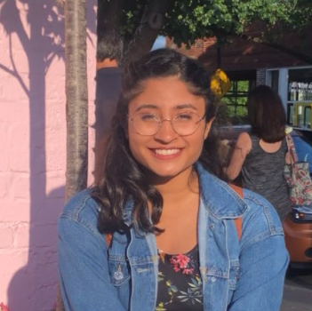
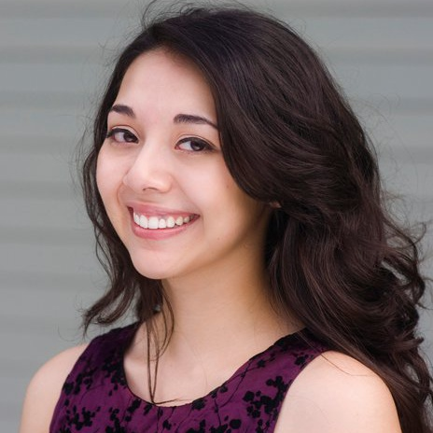
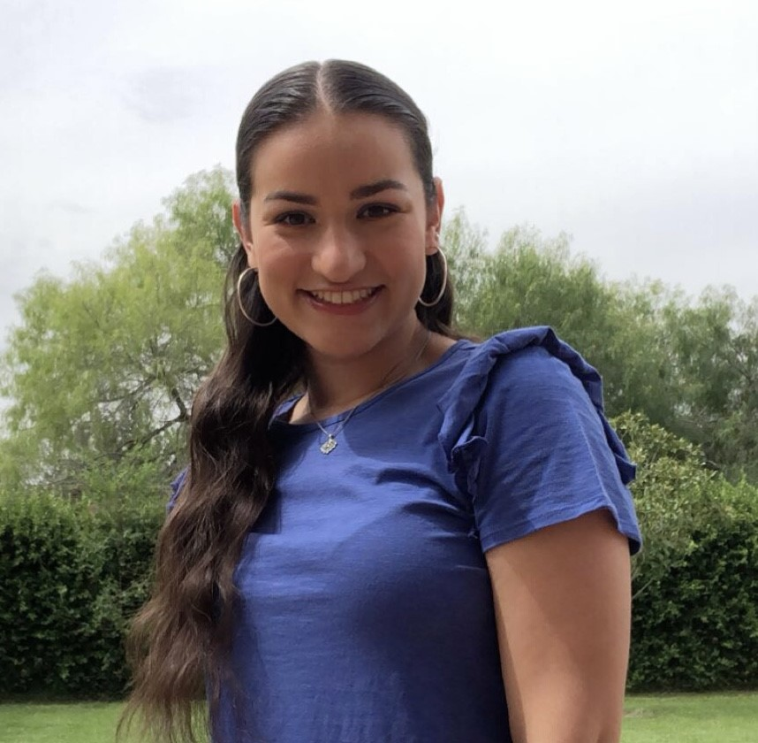
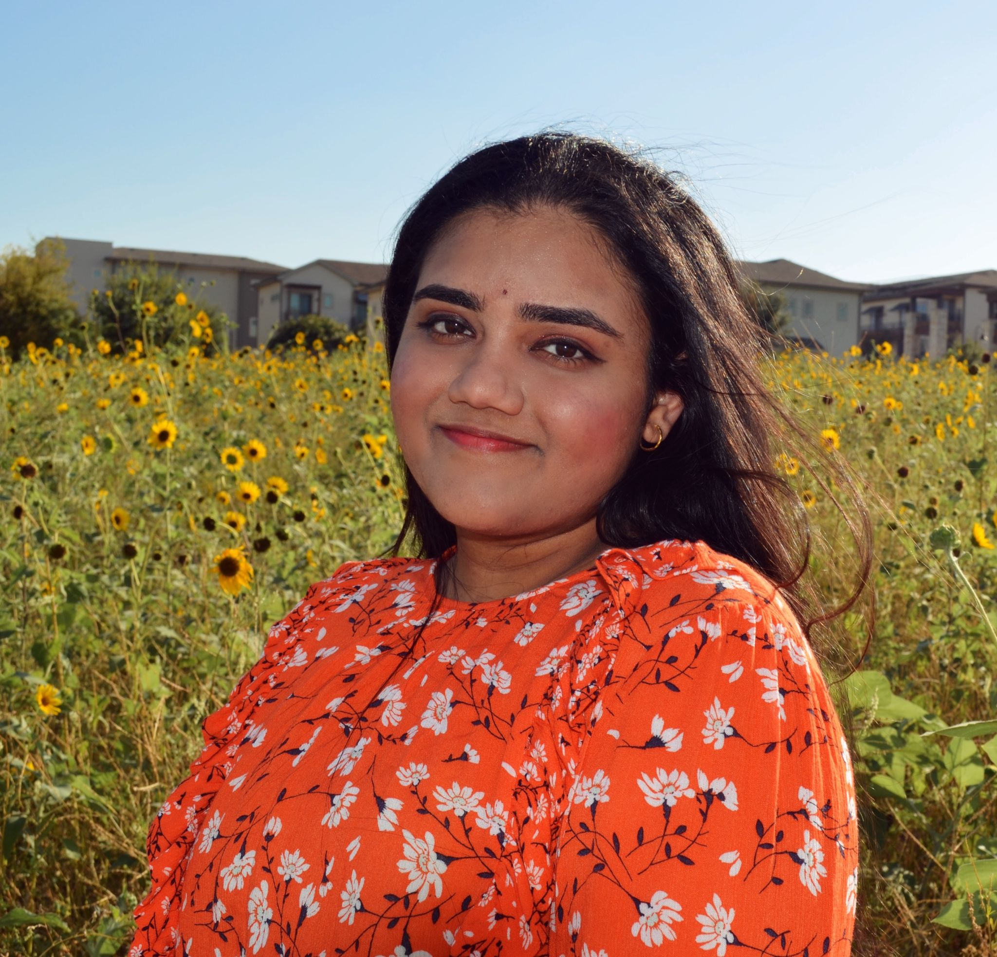
Meet Our Team!
Aishani De Sirkar Computer Science
Computer Science
Junior
Interested in Web Development, Cloud Computing, and Cybersecurity
Sarah Tao Electrical Engineering
Electrical Engineering
Sophomore
Interested in power, robotics and aerospace
Gabriela Saenz Computer Science
Sophomore
Interested in Artificial Intelligence, Web Development, and UI/UX Design
Geetika Vedula Computer Engineering
Sophomore
Interested in UI/UX Design, Machine Learning, and Circuitry

Slide 3
The Problem
1

Slide 4
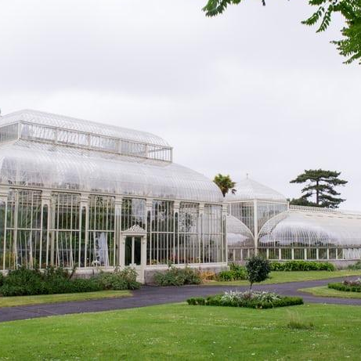
Problem Statement
We must create radical change in order to implement a system that is environmentally sustainable.
We want to create food systems within environmental limits.
By the year 2050, there are projected to be approximately 10 billion people on Earth. The current food system is already reaching the limits of its capacity, parasitic to the state of our environment. There is an urgent need for transformation to prevent catastrophe in the future.

Slide 5

The Question

Slide 6
Background Info
White
Is the color of milk and fresh snow, the color produced by the combination of all the colors of the visible spectrum.
Black
Is the color of ebony and of outer space. It has been the symbolic color of elegance, solemnity and authority.

Slide 7
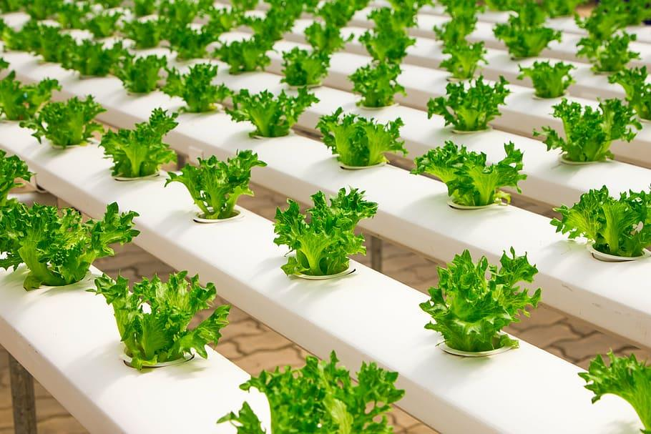
How do we encourage sustainable farming that diminishes the environmental damage of current systems, revives our natural resources, and combats climate change?

Slide 8
Our Solution
2

Slide 9
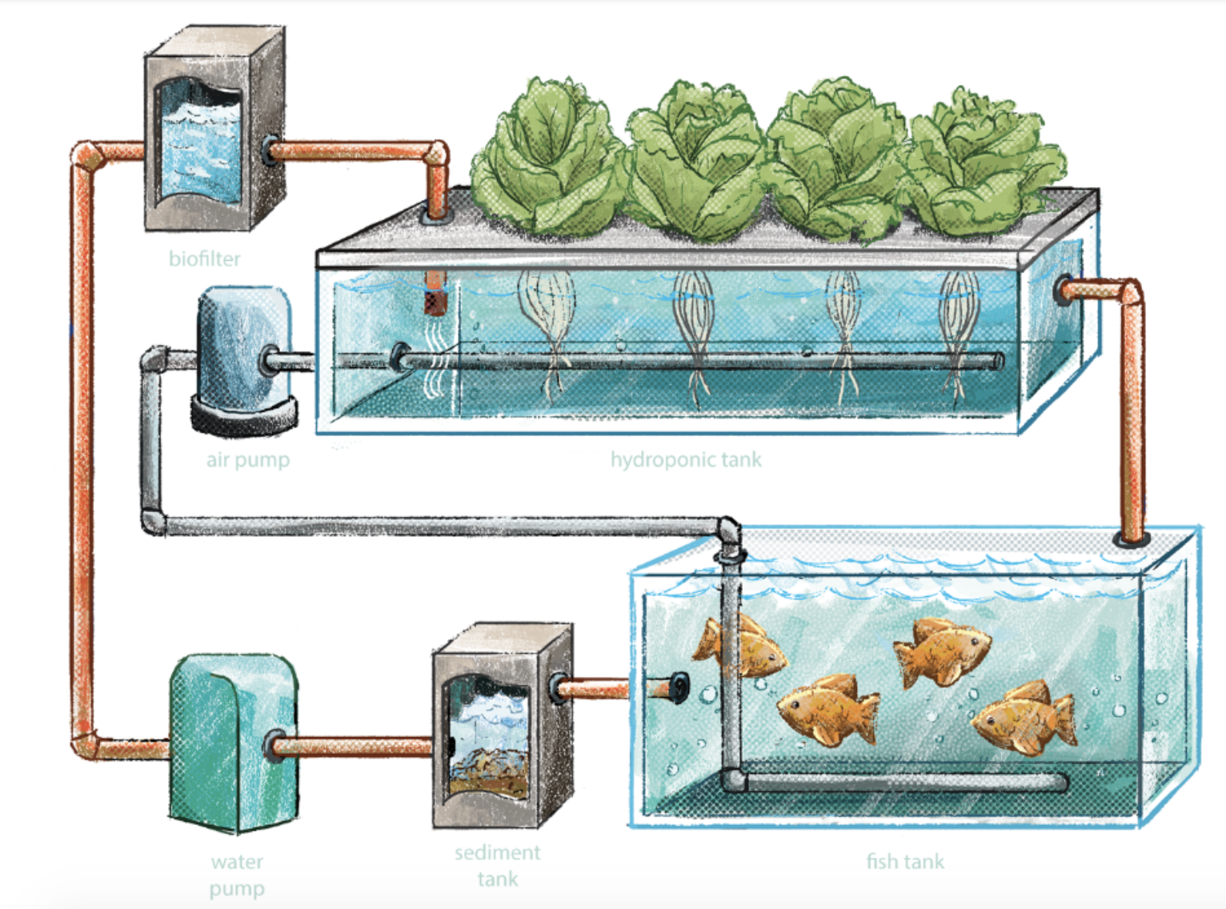
Aquaponics
Agriculture that combines raising fish with soilless plant culture
Water and land conservation
Notes:
Water conservation, using 90% less water than traditional farming
Land conservation, grows 6 times more per square foot than traditional farming, soil degradation

Slide 10
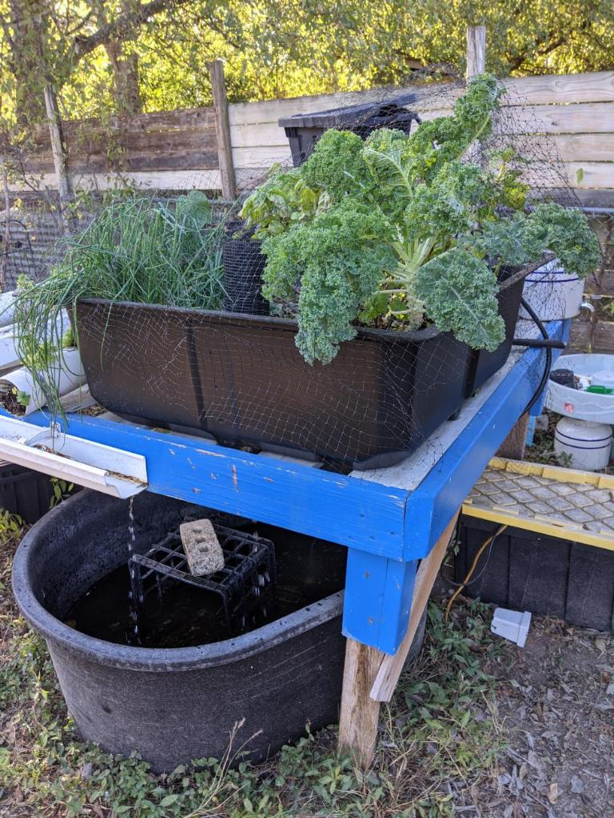
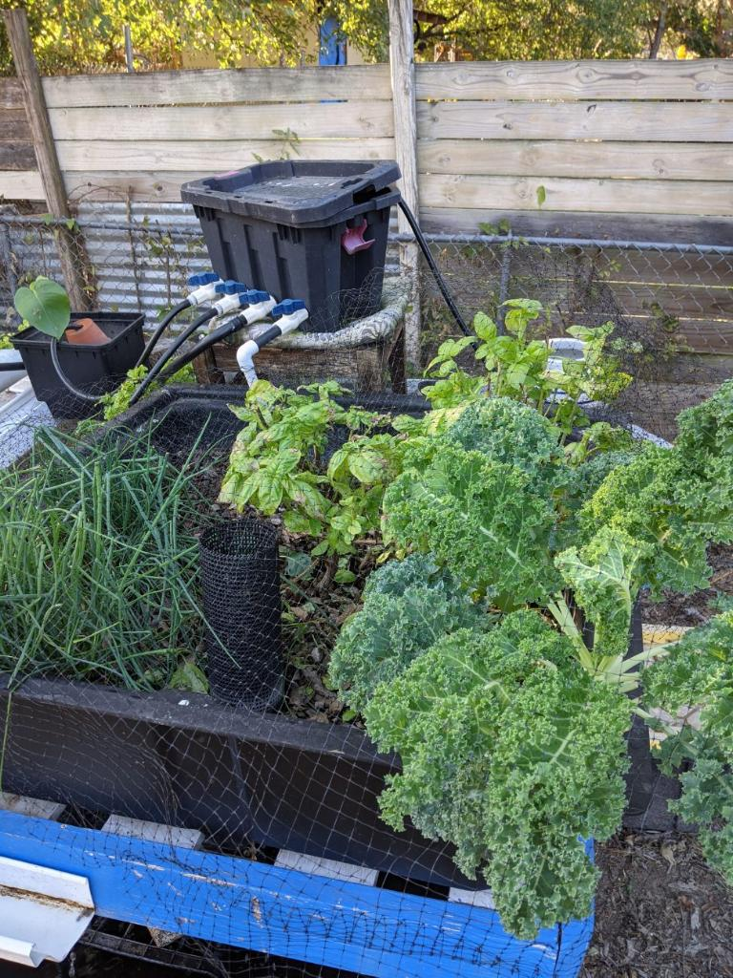
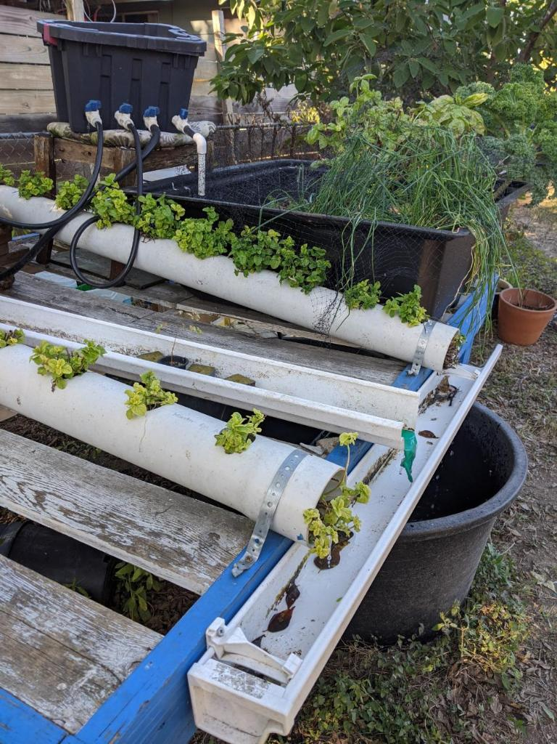
In two or three columns
Aquaponics Setup

Slide 11
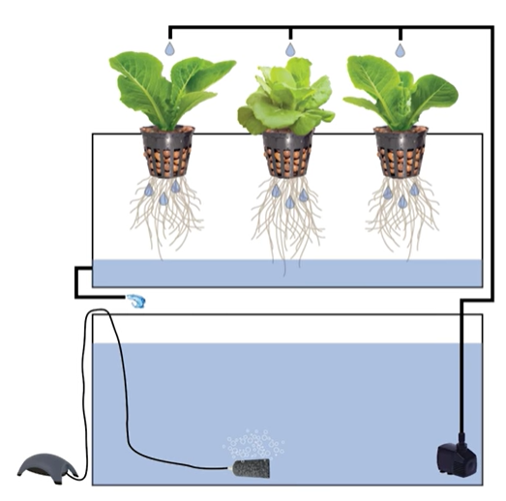
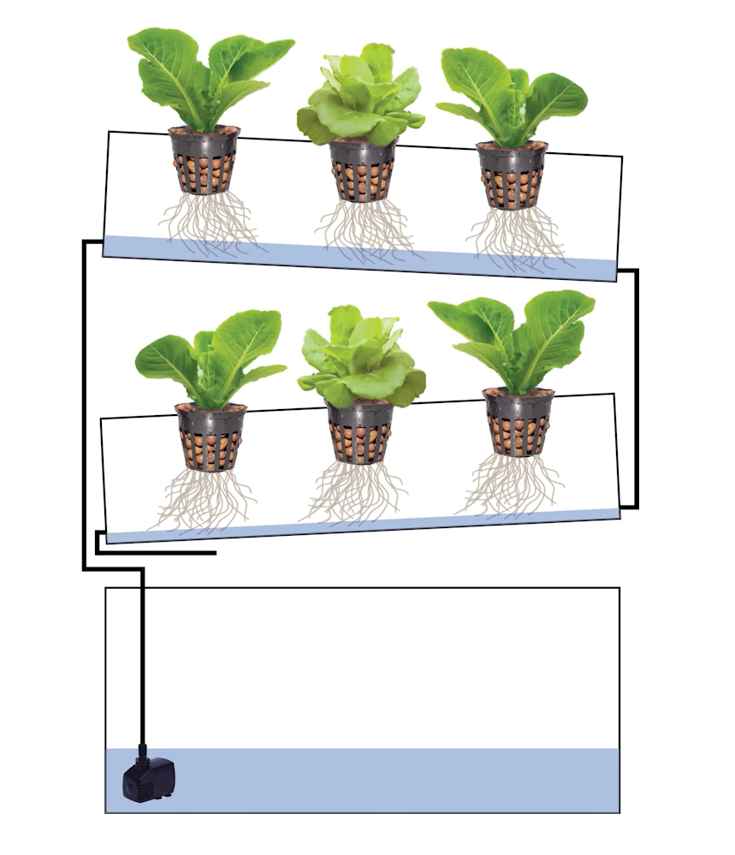
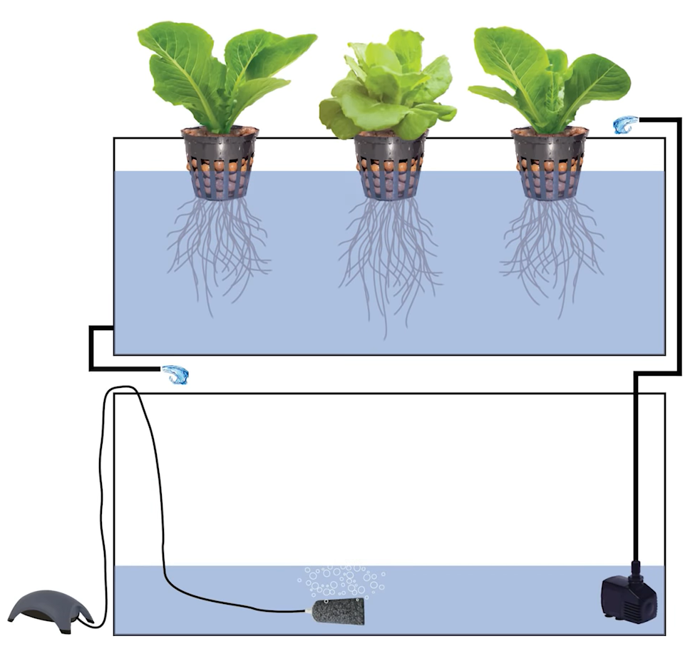
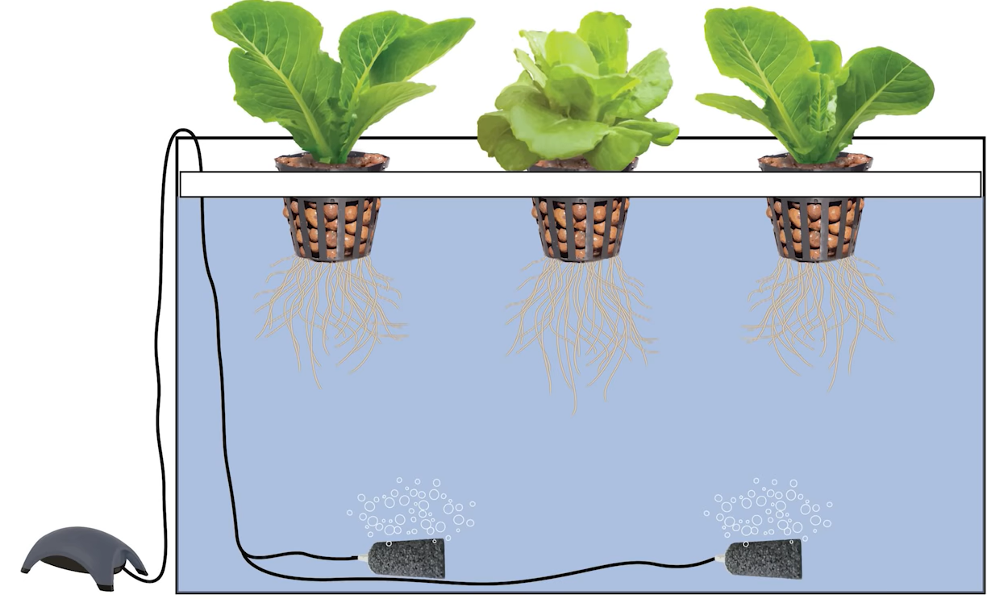
Types of Hydroponic Systems
Nutrient Film Technique
Deep Water Culture
Drip
Ebb and Flow
Notes:
Sarah

Slide 12
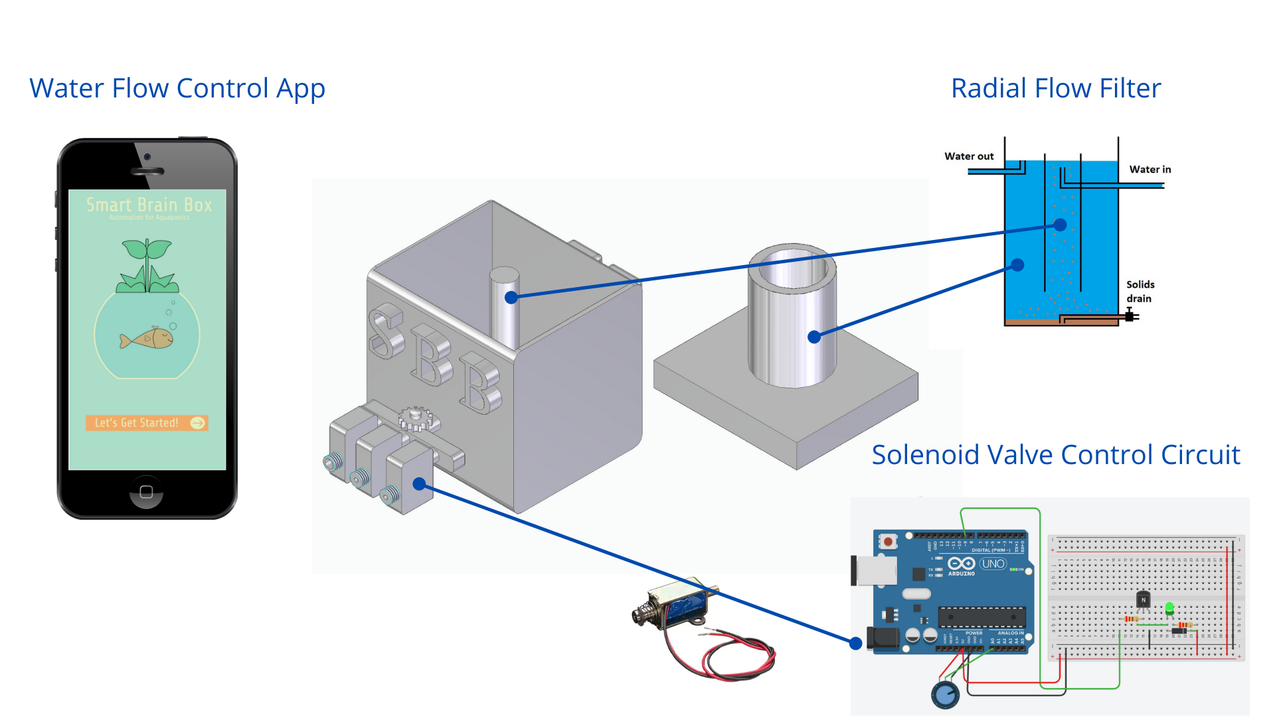
Smart Brain Box

Slide 13
Target Consumers
-
Notes:
Caitlin’s Tip: Move after explanation

Slide 14
Target Consumers Info
Scope: Small scale - aim to distribute for backyard use
Agriculturalists
Increase the use of aquaponics in regular homes
efficient setup / yield the most crops
Unmanned, normal family-friendly
Automated
More control over flow direction
No overflow and dripping

Slide 15
Process
3

Slide 16
Tech Stack
SBB Mobile App
Water Controls
Design
JavaScript
React Native
Figma
Expo Go
Notes:
Don’t like. Will Edit.
While we created our product, we had the opportunity to learn some great new pieces of technology. When it came to the Smart Brain Box App, we were able to break into up into two parts:
I’ll pass it on to Geetika to talk about our Cost Analysis.

Slide 17


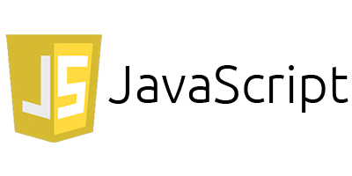
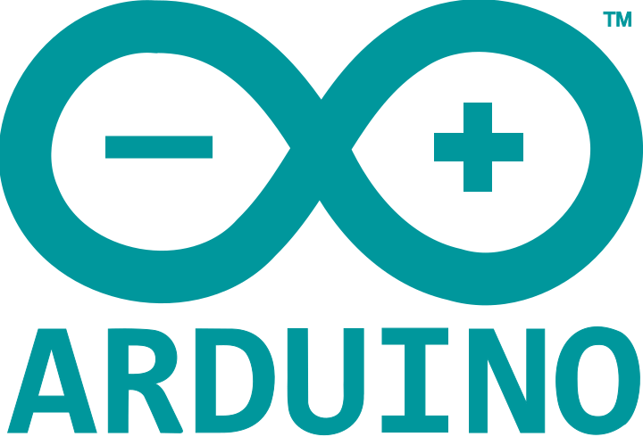


Tech Stack
Notes:
Thank you geetika, while we created our product we had the opportunity to learn some cool new pieces of technology. These included tech that touched on both the software and hardware side of our product. To build the Smart Brain Box App we laid out the original design with Figma, we chose to use Figma because it offered a very user friendly way to learn app design. The same went for our choice to use JavaScript and React Native to build a functioning app. React Native offers a lot of tutorials and easy to use controls. Putting these two factors together was made simple with Expo Go, a development product that allowed us to make our changes to the code and see the updated app on our phones in real time, creating a very smooth work flow.
In addition, we used Solid Edge technology to create the 3D model of the box and arduino uno to build the circuitry that is involved with connecting the mobile app to the smart brain box itself. With this whole tech stack we learned a lot about development and we were glad to have had the opportunity to learn some new skills. With that being said I’ll pass it back to Geetika so she can go over our product cost analysis.

Slide 18
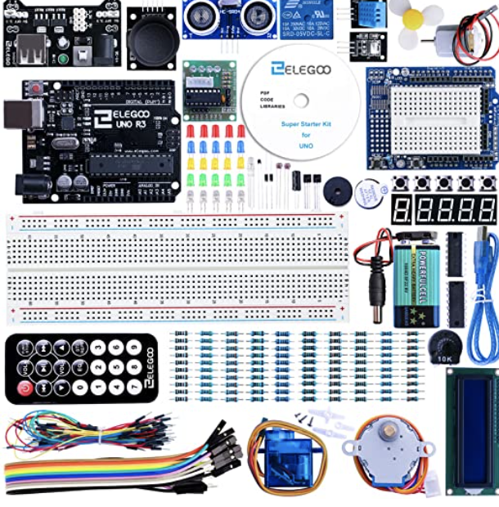
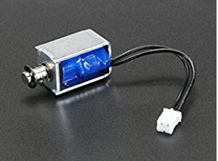
Cost Analysis
 | Price |  | Specs |  | Link
Solar Panels | $15.39 |  | Power: 4.2W Voltage: 12V Operating Current: 0~350mA |  | Website
Arduino and Circuit Components | $20.48 $29.75 |  | Microcontroller Microchip Operating Voltage 5V Digital I/O Pins 14 Analog Input Pins 6 Flash Memory 32 KB |  | Website Alternative
Box Material | $55.00 |  | 16.25 x 14 x 15 inches 21 LBS 16 Gauge Galvanized Steel |  | Website link
Solenoid Valves | $13.78 ea. |  | 5V 12V |  | Website Alternative
Total: ~ 113.92
Notes:
Caitlin’s Tip: Add total cost

Slide 19
DEMO!
Our product in action.

Slide 20
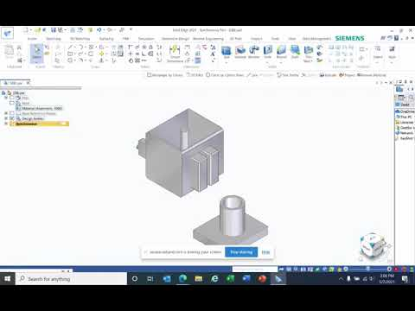
Brain Box 3D Model

Slide 21
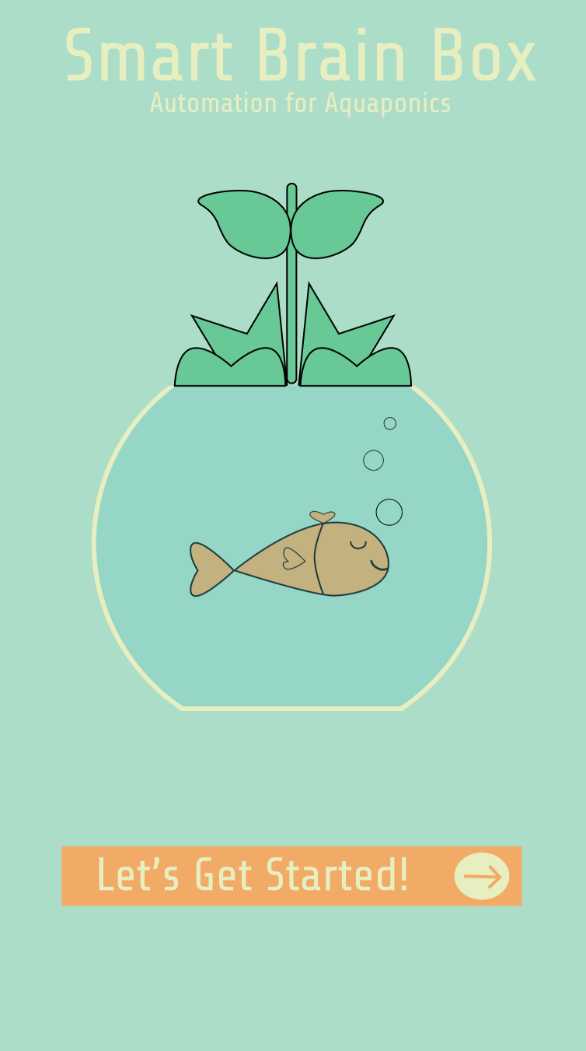
Mobile App
Built for user convenience.
Water Controls make the system automated, controlling the valves right from the user’s phone.
Notes:
Thanks Geetika. So what you can see here is the design that was made to be the home page for the Smart Brain Box mobile App. As you can see we wanted to make it clear that this app is Automation for Aquaponics. We built the app with the intention of being user centric. Everything that is created is for the users convenience. The water controls themselves allow the user to do everything from the comfort of their phone, without ever having to worry about a complicated piece of technology. Now I’ll go ahead and demonstrate the app for you all.

Slide 22

App/Water Controls

Slide 23
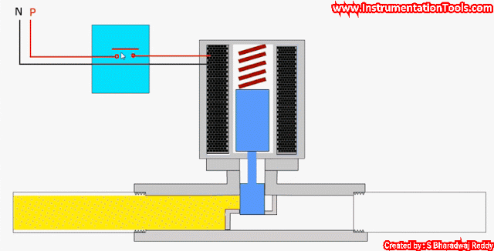
Valves

Slide 24
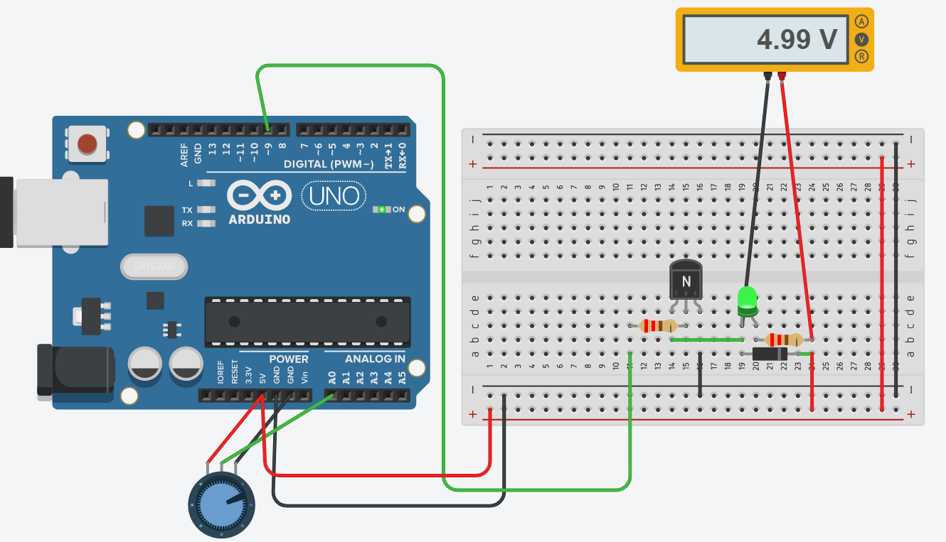
Circuit

Slide 25
Circuit

Slide 26
Challenges
Connection between the Arduino and the valves
Estimation of how many volts needed for solar panel
Feasibility of connections
Learning new technology and coding languages
Estimation of 3D model vs. real life model
Notes:
This semester we faced some new and interesting challenges. Some of which being a result of working in a virtual environment. Those include Connection between the Arduino and the valves and the feasibility of all the connections involved in the system. It was hard to figure out if our product worked because we didn’t have the physical work space together or the tools to test them out the way we’d hoped to, but

Slide 27
Stretch Goals
Sensors
Data collection, predictions
03
Connecting Real Valves
Power boost
01
02
IoT Connectivity
Additional parts and code

Slide 28
Questions?
Notes:
Thank Caitlin!!

Slide 29

Thank you for listening!

